Slide 1

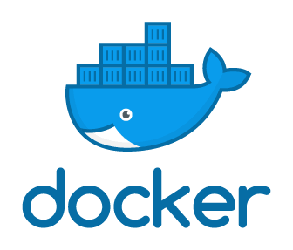
Introduction To Docker
A little bit of background with plenty of hands-on practice
Notes:
// TODO

Slide 2
If you want hands-on practice…
Create a Docker Hub Account
https://hub.docker.com/signup
Download and install Docker Desktop
https://www.docker.com/products/docker-desktop
Connect to the ATC VPN
https://atc-support.apps.wwtatc.com/vpn_access
Download this presentation from WWT’s internal GitHub
https://github.wwt.com/hullt/docker-foundations
Install a code editor
https://code.visualstudio.com/Download
Wait a few minutes while we get through a Docker overview
Notes:
// TODO

Slide 3
Part I
Docker Background
Notes:
// TODO

Slide 4
Why is Does Docker Matter?
Helps use fewer resources than virtual machines
Creates portability between different operating systems and clouds
Easy to spin up and spin down, rapidly
Translation – Docker helps organizations move faster, be more agile, and save money
Notes:
// TODO

Slide 5
What is Docker?
“Docker is a set of platform as a service products that use OS-level virtualization to deliver software in packages called containers. Containers are isolated from one another and bundle their own software, libraries and configuration files; they can communicate with each other through well-defined channels.”
https://en.wikipedia.org/wiki/Docker_%28software%29
Okay…then what in the heck is a container?
Notes:
// TODO

Slide 6
What is Container?
“OS-level virtualization refers to an operating system paradigm in which the kernel allows the existence of multiple isolated user space instances called containersprograms inside of containers can only see contents and devices assigned to the container.”
https://en.wikipedia.org/wiki/OS-level_virtualization
Confused? Let’s compare virtual machines and containers…
Notes:
// TODO

Slide 7
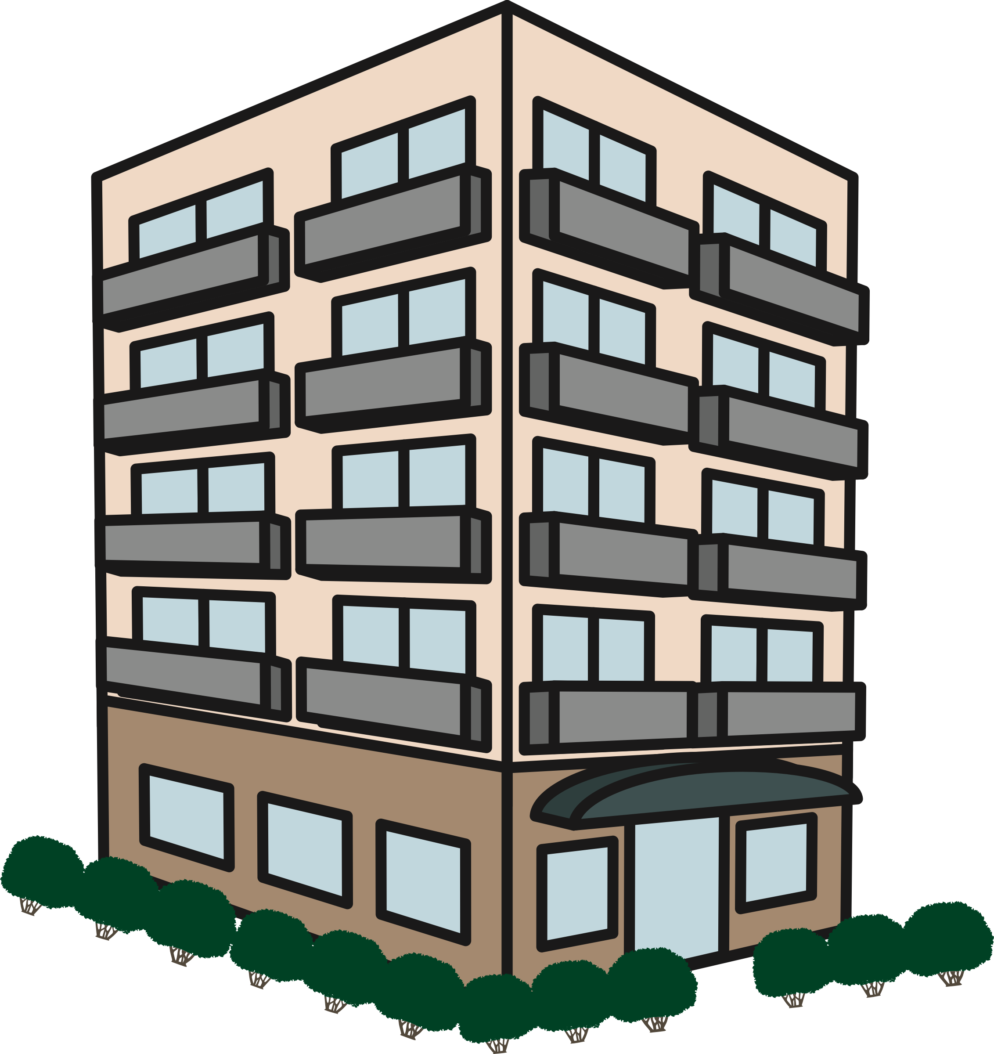
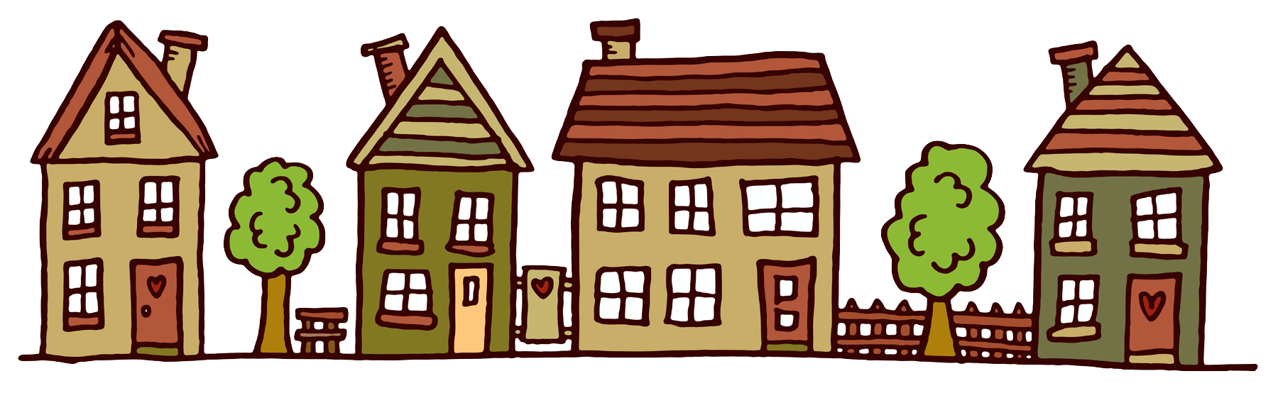
Comparing Virtual Machines and Containers
Virtual Machines ≈ Houses
Containers ≈ Apartments
Fully self-contained
Safeguarded from unwanted guests
Dedicated utilities
Dedicated rooms – kitchen, dining room, family room, living room, etc.
Isolated living spaces
Safeguarded from unwanted guests
Shared utilities
Shared rooms – kitchen/dining room, family/living room etc.)
Notes:
// TODO

Slide 8
Why buy a house…
…if all you need is a place to sleep and eat?
Notes:
// TODO

Slide 9
Virtual Machine and Container Architecture
Type 1 Virtualization
Type 2 Virtualization
Containerization
Virtual Machines
Containers
App
App
App
App
App
App
Virtual Machines
App
App
App
Bin/Libs
Bin/Libs
Bin/Libs
Bin/Libs
Bin/Libs
Bin/Libs
Bin/Libs
Bin/Libs
Bin/Libs
OS
OS
OS
App
App
App
OS
OS
OS
Bin/Libs
Bin/Libs
Bin/Libs
Hypervisor (Type 2)
Docker Daemon
Hypervisor (Type 1)
Host OS
Host OS
Bare Metal
Bare Metal
Bare Metal
Notes:
// TODO

Slide 10
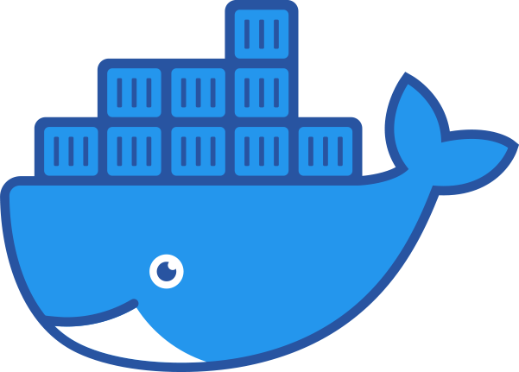



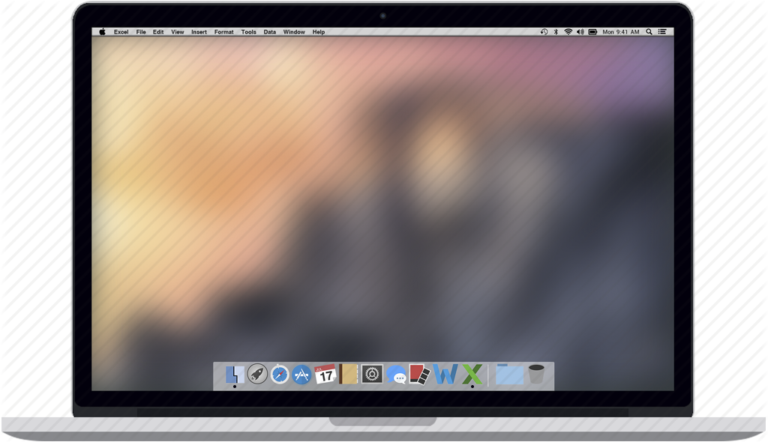



Wins for Docker
Standardized developer environments
Distributed, especially multi-cloud, environments
Micro-services architectures
Cross-OS tool usage
Service C
Service C
for x in range(3):
print(x)
Service B
Service B
Service A
Service A
Notes:
Standardized developer environments – standardize development tools, platforms, dependencies, etc.
Distributed, especially multi-cloud – containers are highly portable without requiring re-platforming
Micro-services architectures – isolate processes/services, each component of an application; if one service fails, the application can still mostly function
Cross-OS tool usage – download/install/run a Linux tool on Windows or macOS platforms, within a Docker container

Slide 11
Docker Engine Overview
Client
containers
docker CLI
networks
manages
REST API
manages
Server
images
data volumes
docker daemon
Notes:
// TODO

Slide 12
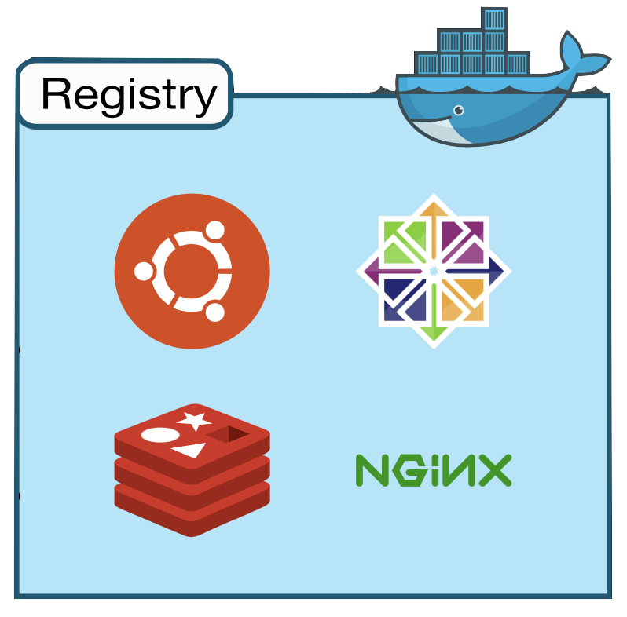
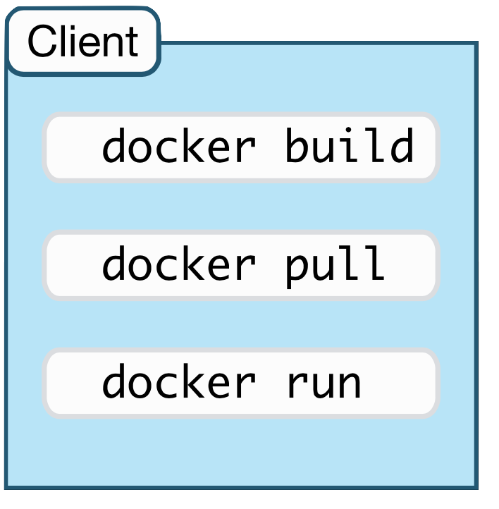
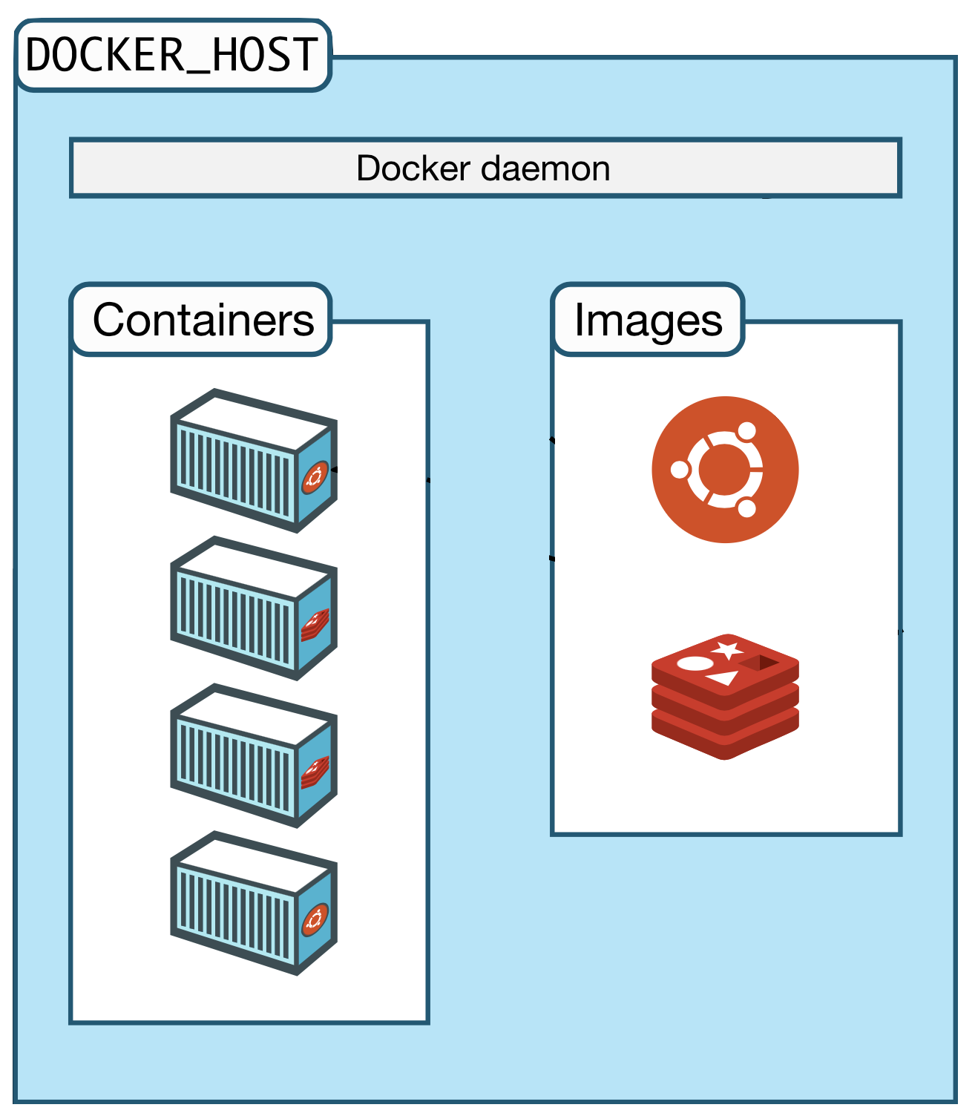
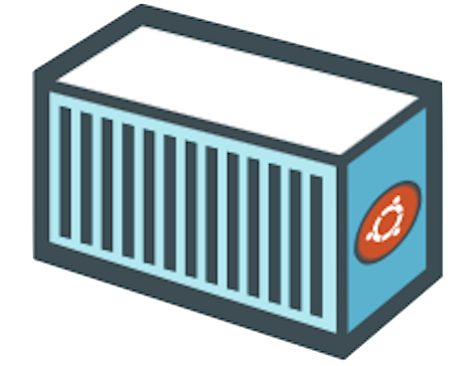

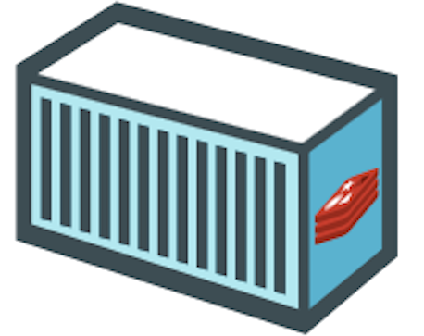

The Docker Architecture
Notes:
// TODO

Slide 13
Part II
Docker Hands-On
Notes:
// TODO

Slide 14
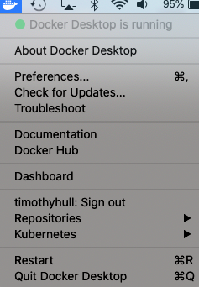
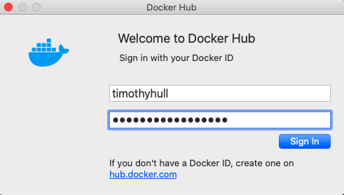
Sign In to Docker Desktop
Open/start Docker Desktop
Log on with your Docker Hub account
Notes:
// TODO

Slide 15
Verify Your Docker Installation
Open your preferred terminal (bash, PowerShell, zsh, etc.)
Enter the commands:
docker --version
docker info
docker run hello-world
Notes:
// TODO

Slide 16
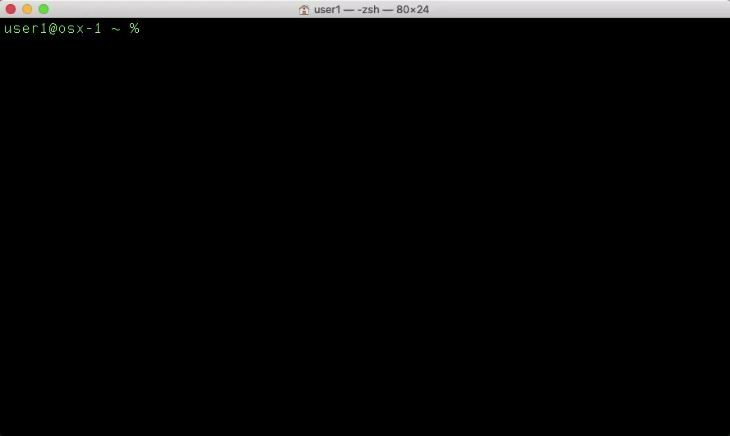
Release Year
Release Month
Notes:
// TODO

Slide 17
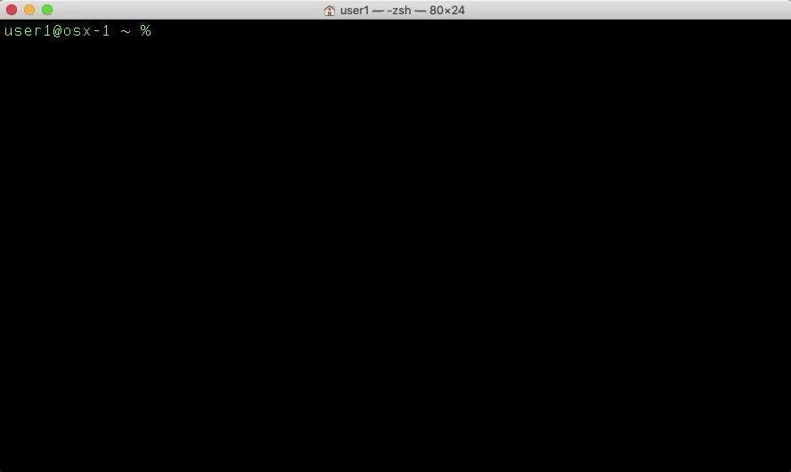
Notes:
// TODO

Slide 18
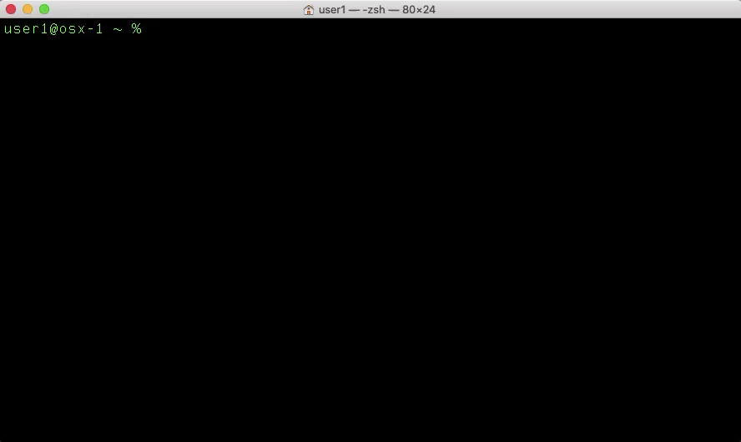
Notes:
// TODO

Slide 19
Docker Images
Immutable templates for Docker Containers
Built using a Dockerfile with all required binaries, packages, etc.
List your Docker Images with the terminal command:
docker image ls
Notes:
// TODO

Slide 20
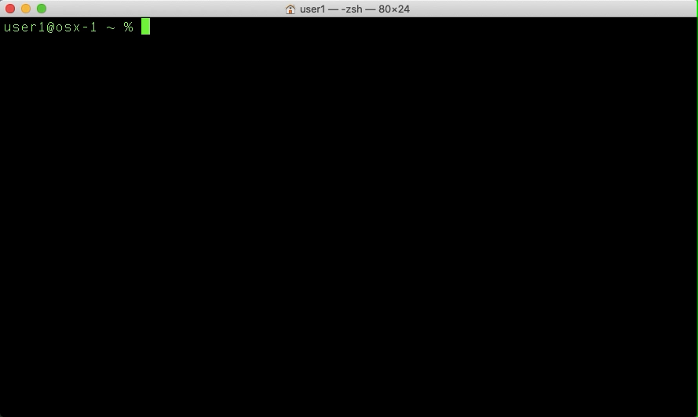
Notes:
// TODO

Slide 21
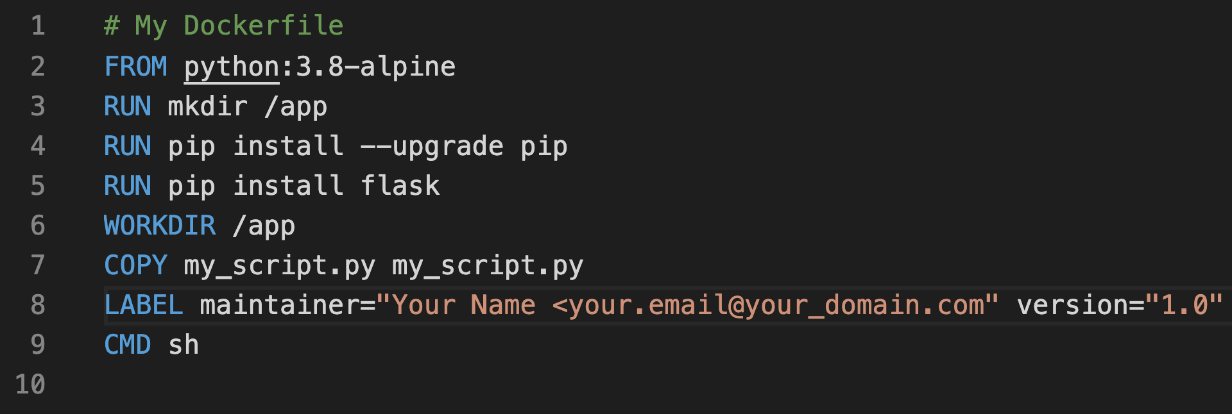
The Dockerfile
The Docker Image blueprint, read from top to bottom
A text file named “Dockerfile”
Comprised of UPPERCASE instructions
Each instruction represents a layer of the image
Notes:
// TODO

Slide 22


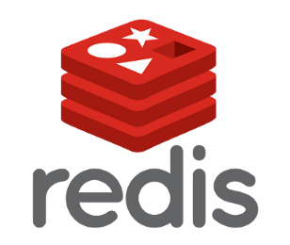
The Dockerfile
Dockerfile
FROM python:3.8-alpine
RUN pip install flask
RUN apk add redis
CMD sh
Notes:
// TODO

Slide 23
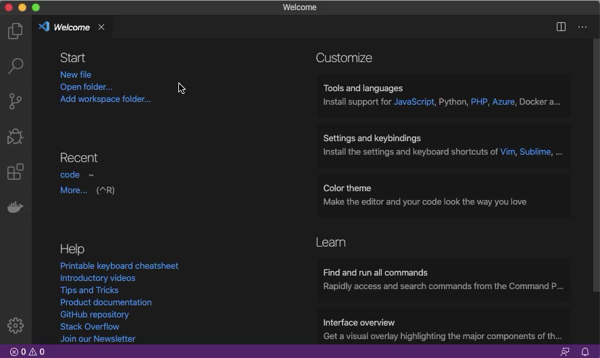
Notes:
// TODO

Slide 24
The FROM Instruction
Always the first instruction, specifies base OS image
Base image index available on https://hub.docker.com
Formatted using tags
FROM python:3.8-alpine
FROM Instruction
Alpine Linux OS
Python official image
Python version 3.8
https://hub.docker.com/_/python
Notes:
// TODO

Slide 25
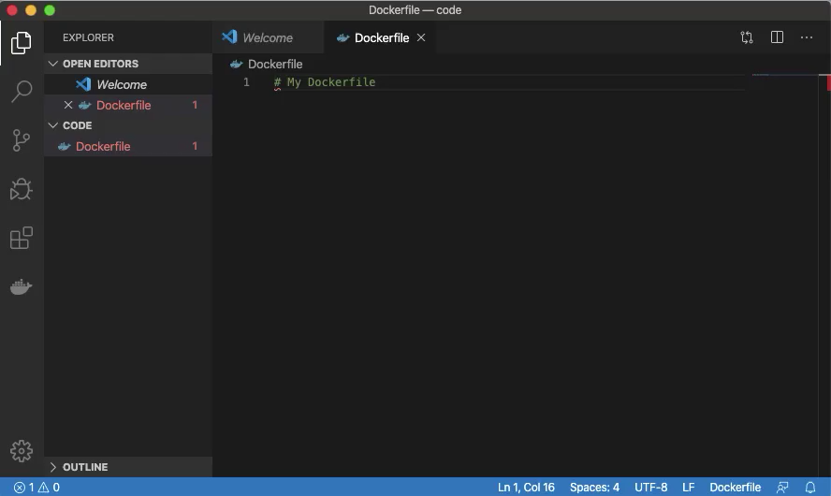
Notes:
// TODO

Slide 26
The RUN Instruction
Runs any command/script available in the OS
Create directories (mkdir), install packages (pip, apk, yum, etc.), run scripts, etc.
RUN mkdir /app
RUN Instruction
Shell Command
RUN pip install --upgrade pip
RUN pip install flask
RUN apk add redis
Notes:
// TODO

Slide 27
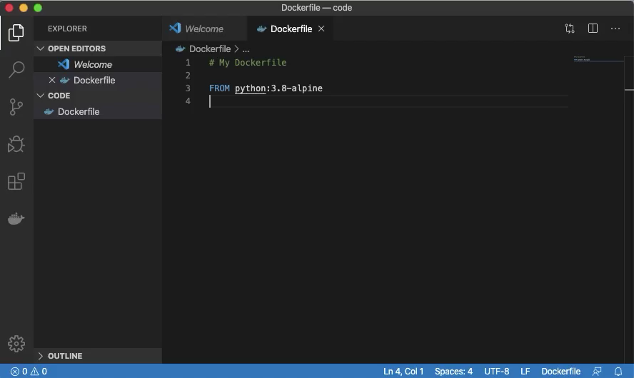
Notes:
// TODO

Slide 28
Notes:
// TODO

Slide 29
Docker Containers
Notes:
// TODO

Slide 30
Downloading & Storing Images
Notes:
// TODO

Slide 31
Build Docker Images
docker image build -t nnn .
docker image ls
docker image push
docker image rm
Notes:
// TODO

Slide 32
Create Docker Containers
docker container ls [-a]
docker container run
Flags
i
t
d
--name
--rm
Ctrl P + Q
Ctrl D
docker container start/stop/attach/rm
docker container stop container1 container2 container3
docker container stop $(docker container ls -a -q)
Notes:
// TODO

Slide 33
Mount Local Volumes to Docker Containers
Notes:
// TODO

Slide 34
Port Forward to Docker Containers
Notes:
// TODO

Slide 35
Cleaning Up
docker system df [-v]
Dangling images (<none> repository and tag names)
docker system info
docker system prune
docker image/container prune
Notes:
// TODO

Slide 36
Notes:
// TODO

